Slide 1
Glaciers and Glaciation
Arkansas Headwaters Recreation Area
Version 3.1
Bob Hickey

Slide 2
Glaciers
What is a Glacier ?
  A thick mass of ice
  Forms over land
  The accumulation, compaction, and recrystallization of snow
  Moves slowly (2 meters per day or less on average)
  Accumulates, transports, and deposits sediment

Slide 3
Glaciers
Types of Glaciers
  Valley Glaciers (or Alpine Glaciers)
    Glaciers that follow faults, fractures, and former valleys
    Streams of ice bounded by rock walls
    Flow downstream from a snow accumulation head zone
    Width is generally small compared to the length (Hubbard Glacier is 70 miles long)
  Sheet Glaciers
    Exist on a much larger scale than Valley Glaciers (sometimes called Continental Ice Sheets)
    Flow out in all directions from a snow accumulation center
    Cover all but the highest areas of the underlying terrain
    Topographic land features guide the flow in certain directions and affect rate of movement
    Greenland and Antarctica are covered by these ice sheet glaciers

Slide 4
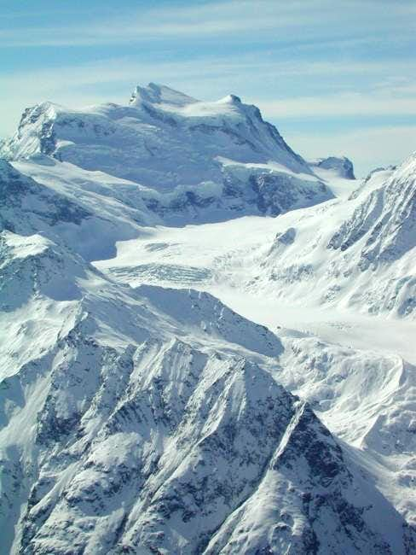
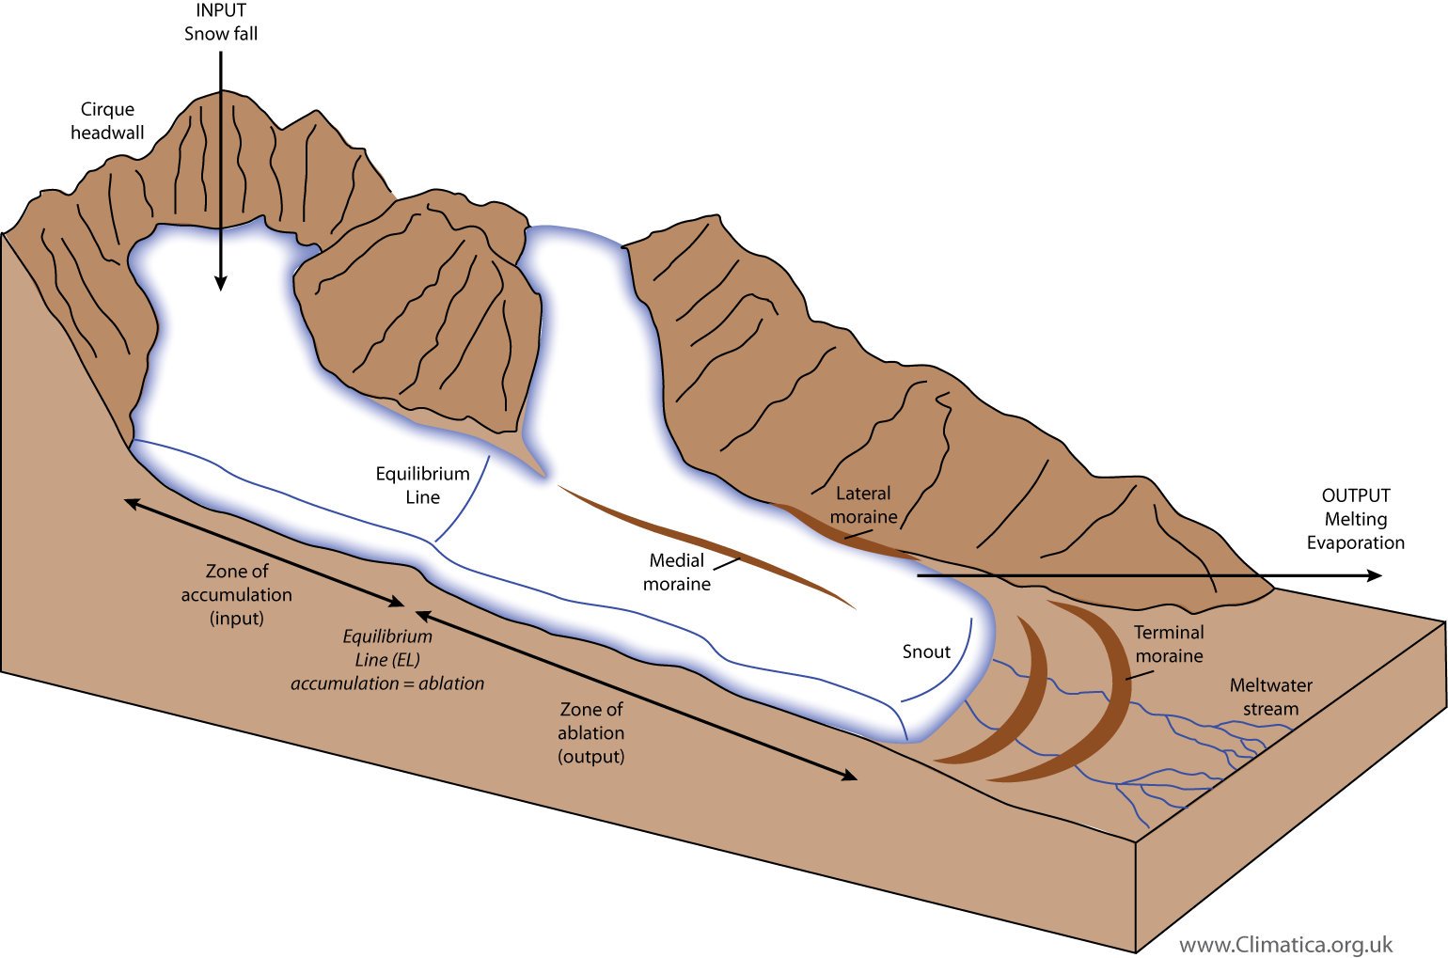
Alpine Glaciers
Glacier Characteristics
Glacier Diagram

Slide 5
Glaciers
Types of Glaciers (cont.)
  Rock Glaciers
    What is a Rock Glacier ?
      A mass of course rock, an ice matrix, mud, and water moving slowly down-mountain under the influence of gravity that may grow to over 100 feet thick and grow in length to over a mile
      Its characteristics are influenced primarily by sediment (rock) and ice/water inputs
      Movement is due to cumulative plastic deformation of the thermally controlled ice/rock mixture and may be from a few centimeters up to several feet per year
      It has steep sharp-crested front and side cascading slopes and a surface of ridges and furrows giving the wrinkled look
      The ice needs to be deep enough so that the active upper permafrost layer (layer that seasonally thaws) has no effect on it
    There are two types of rock glaciers
      Glacial Rock Glacier – at one point, active glaciers where the decay of ice was replaced with a remnant massive glacial ice core and plugs and a large amount of ice-saturated talus and unsorted rock debris (now very reliant on landslide rock debris/talus) protecting the ice from melting
      Ice-Cemented (Permafrost/Periglacial) Rock Glacier – intense freezing cycles (frost) and the melting of snow cause the core of the rock glacier to form consolidated material supersaturated with subsurface interstitial ice and ice lenses as an insulating talus rock mantle accumulates on top

Slide 6
Glaciers
Types of Glaciers (cont.)
  Rock Glaciers (cont.)
    There are two landforms of rock glaciers
      Lobate (or lobed) Rock Glacier – possess greater width than length where the talus is derived from multiple adjacent enclosing valley walls and usually originate from talus and contain interstitial ice
      Tongue-Shaped Rock Glacier – possess greater length than width and normally confined to narrow valleys and cirques where talus is derived from steep rocky highlands at the head of the glacier and originate from ice-cored rock glaciers or ice-cemented rock glaciers
    Common Rock Glacier process characteristics
      Active – rock glaciers with deforming ice due to downslope progression, sharp ridges and surface features, a steep cascading frontal slope of an angle greater than the angle of repose, and the head may merge smoothly with the talus cone
      Inactive – similar characteristics to the above but they no longer move downslope and they have a gentler frontal slope with a more rounded toe crest and mature lichens on the talus
      Fossil – the glacier no longer contains ice, has no downward movement, and is distinguishable by vegetation, especially on the toe, and natural weathering processes visibly occurring on the glacier
    Rock Glaciers A Transitional Form
      With the passage of time, a rock glacier will cease to exist and become a sedimentary deposit
      Because rock glaciers have not been found in the rock record, they are transitional to a moraine or colluvial deposit, which have been found in the rock record

Slide 7
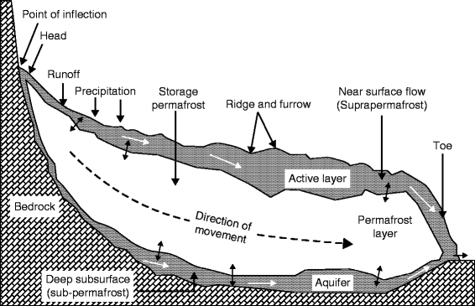
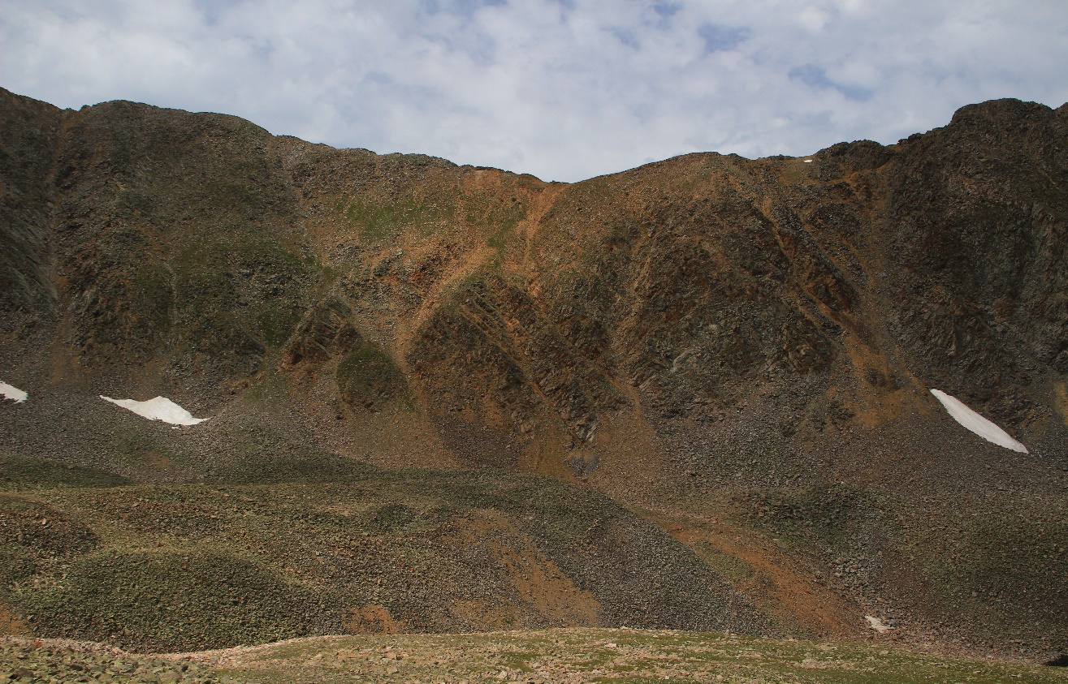
Rock Glaciers
Rock Glacier Diagram
Rock Glacier Characteristics

Slide 8
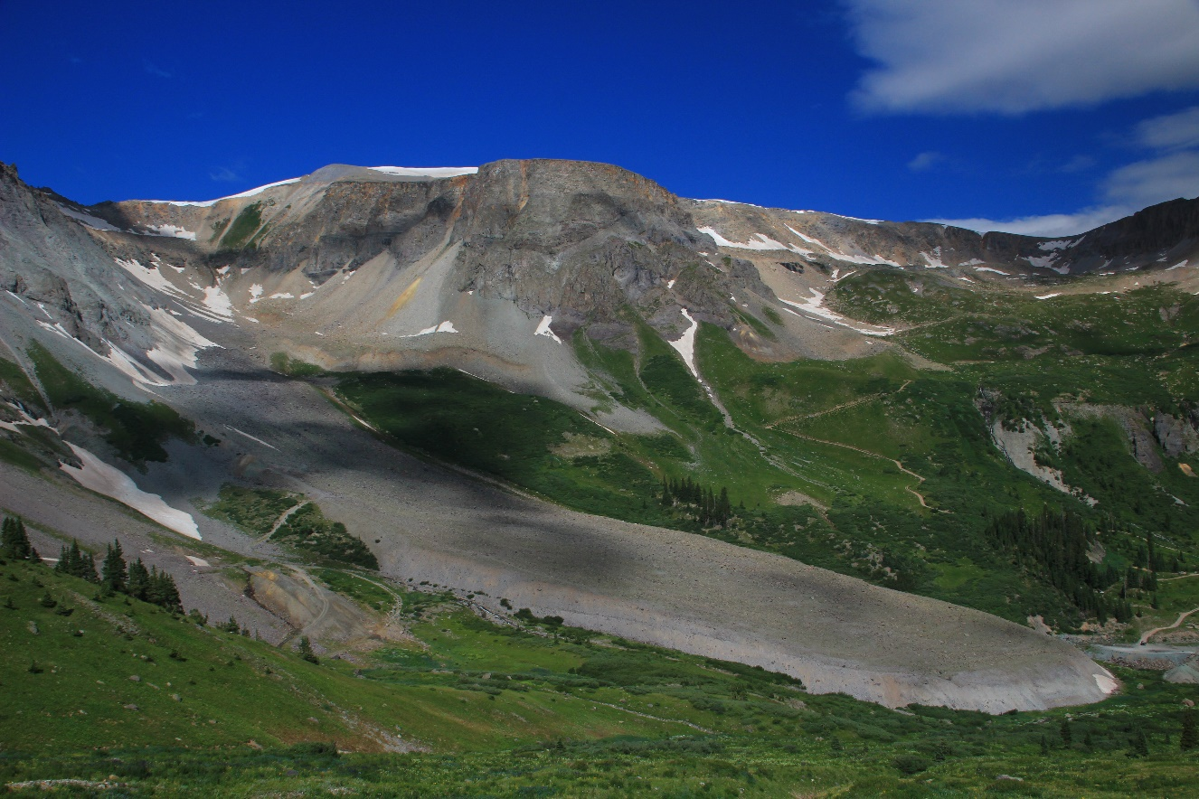
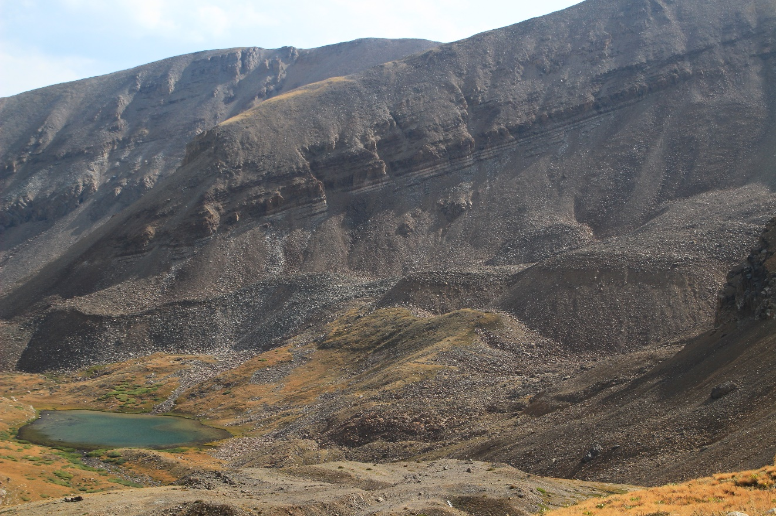
Rock Glaciers
Tongue Rock Glacier – Camp Bird
Lobed Rock Glacier - Horseshoe

Slide 9
Glaciers
Terminology
  Zone of Accumulation
    Area of snow accumulation and ice formation ( usually defined by the snowline) where there is more accumulation than melting annually
  Zone of Wastage
    Area below the Zone of accumulation where melt (all of the annual snowfall and some glacial ice) exceeds accumulation annually
  Calving
    Large pieces of ice break of the front of a glacier – creating icebergs
  Glacial Budget
    The balance between accumulation at the upper end of a glacier and the loss at the lower end
    The loss is called ablation
      If accumulation exceeds ablation, the glacier advances
      If ablation exceeds accumulation, the glacier retreats but it still keeps on moving
  Crevasses
    Cracks in the zone of fracture (upper 50 meters of ice) of a glacier can be 165 feet deep

Slide 10
Glaciation
Erosion
  Ice scrapes, tears, scours, and tears rock from valley floors and walls and carries it down valley
  The glacial ice does not let this debris settle out but can transport huge blocks
  Glacial Erosion
    Plucking
      A glacier loosens and lifts blocks of rock and incorporates them into the ice
      Occurs when meltwater penetrates cracks in the bedrock beneath the glacier and freezes where it expands and pries the rock loose
      This creates sediments from as fine as flour to blocks as big as houses
    Abrasion
      The ice and load of rock fragments slide over bedrock – pulverizing, sanding, and smoothing the surface and creating rock flour and additional fragments
      Large rock fragments in the ice create long scratches and grooves in the bedrock – glacial striations

Slide 11
Glaciation
Landforms
  Cirque
    Bowl-shaped depression at the head of a glacial valley with precipitous walls on three sides and open on the downvalley side
    Focal point for the valley glacier’s growth
    After glacial melt, the cirque basin often has a small lake in it
  Glacial Trough
    Where during glaciation, faults, cracks, and narrow valleys are widened, straightened, and deepened, creating a characteristic U-shaped trough
  Hanging Valley
    Main glaciers (trunk glaciers) cut deeper valleys than their tributary glaciers, leaving the valleys of the tributary glaciers standing above the main trough upon receding of the ice

Slide 12
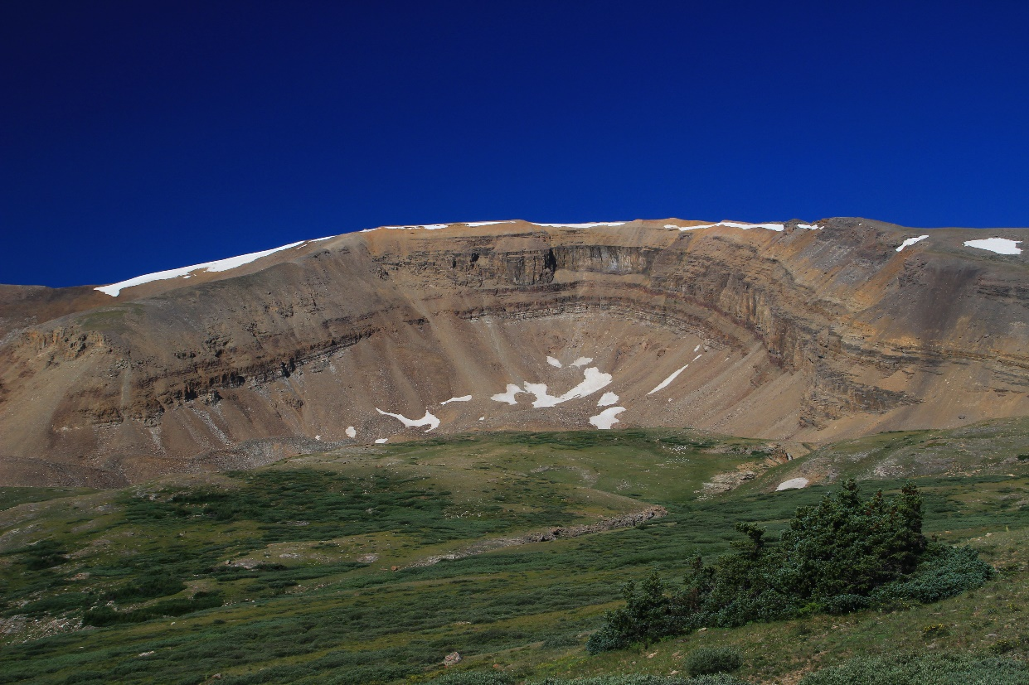
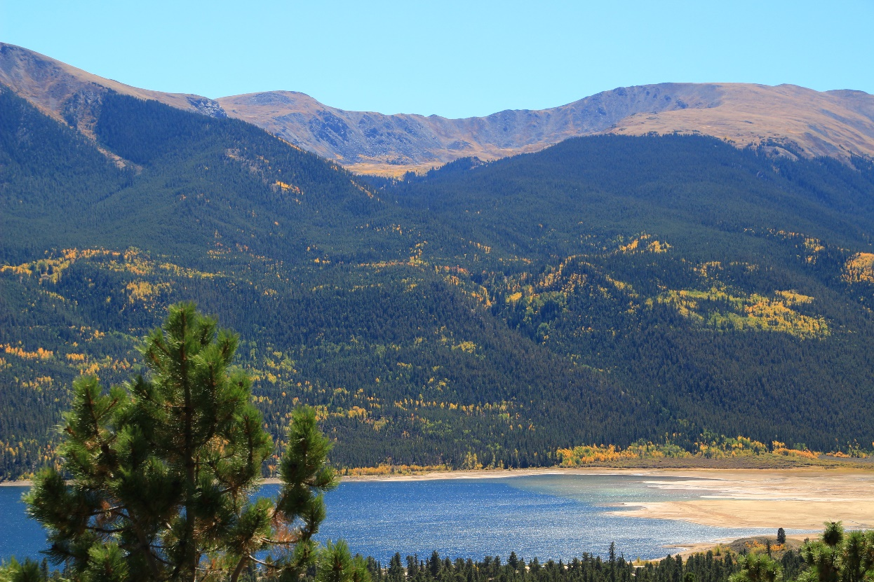
Landforms
Horseshoe Cirque – Sedimentary Rock
Quail Cirque – Crustal Rock

Slide 13
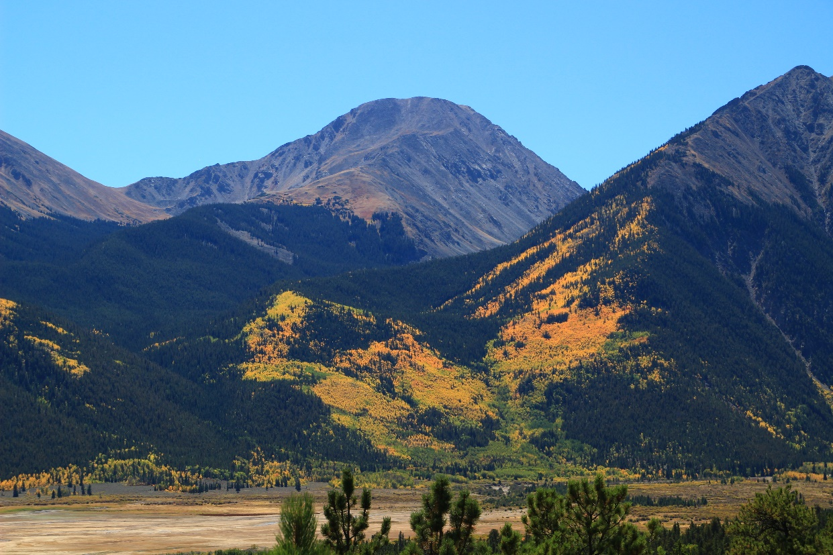
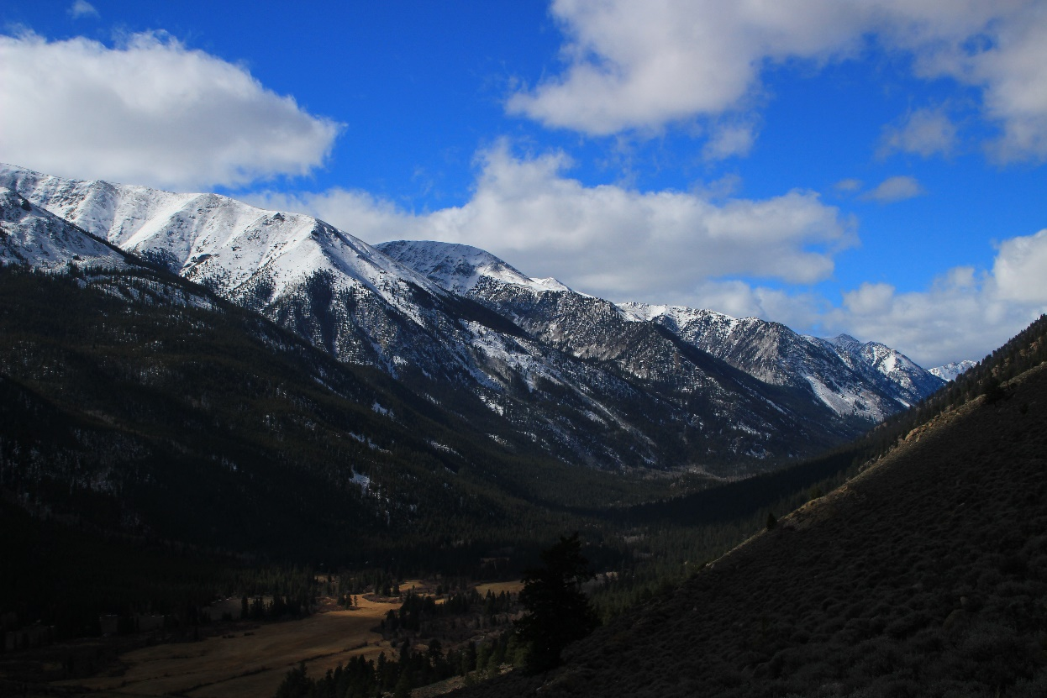
Landforms
Trough – Mt. Hope
Hanging Valley – Mt. Oxford

Slide 14
Glaciation
Landforms (cont.)
  Arête
    Sharp-edged, sinewave-like ridge left from glaciation on both sides of a divide
    Often caused by the enlargement of cirques, reducing the divide to a narrow knifelike partition or by the reduction of the divide by the movement of two parallel tongues of ice on both sides
  Horn
    A sharp pyramid-like peak projecting above the surroundings, often on an arête
    In the case of a spire like Uncompahgre Peak or the Matterhorn, cirques around a single high area can be the cause

Slide 15
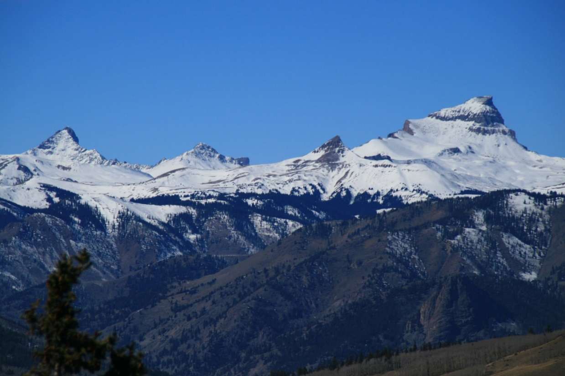
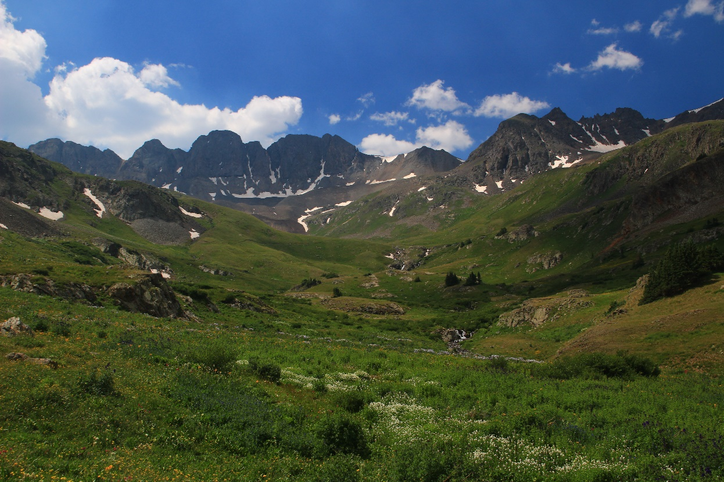
Landforms
Horns – Uncompahgre/Wetterhorn
Arête – American Basin

Slide 16
Glaciation
Glacial Deposits (or Glacial Drift)
  All sediments of glacial origin
  Till
    Materials deposited directly by glacial ice and, thus, unsorted and non-stratified mixtures of glacially-carved materials of many particle sizes
  Stratified Drift
    Materials deposited by glacial meltwater and, thus, sorted according to the size and weight of the material
    Often consists largely of sand and gravel
  Glacial Erratics
    Boulders (often very large) found in the till or lying on the ground surface that are usually different from the bedrock below
    Dropped directly out of the glacial ice as a glacier recedes
  Glacial Outwash
    Water from a melting glacier, full of suspended materials, sweeps out in front of melting ice, slows down, and drops most of its bed load
    Meltwater weaves a complex pattern of braided channels building a broad ramp-like surface of stratified drift adjacent to the downstream edge of the terminus of glacial advance

Slide 17
Glaciation
Moraines
  Lateral Moraine
    Large amount of materials from the erosion of the sides of a valley glacier left as ridges when the glacier recedes
  Medial Moraine
    Formed when two valley glaciers merge to form one ice stream
    Till carried along the edges of each glacier joins to form a single dark strip of debris within the enlarged glacier
    Could not form if the ice did not move downvalley
  End (or Terminal) Moraine
    A ridge of till that forms at the terminus of a glacier
    Deposited when there is a state of equilibrium between ablation and accumulation
    As ice melts, till is dropped and the end moraine grows
    The longer the ice front remains stable, the larger the moraine will grow
  Kettles
    Basins or depressions in outwash plains and till deposits formed from buried blocks of ice in the glacial drift that eventually melt (often later filling with water)

Slide 18
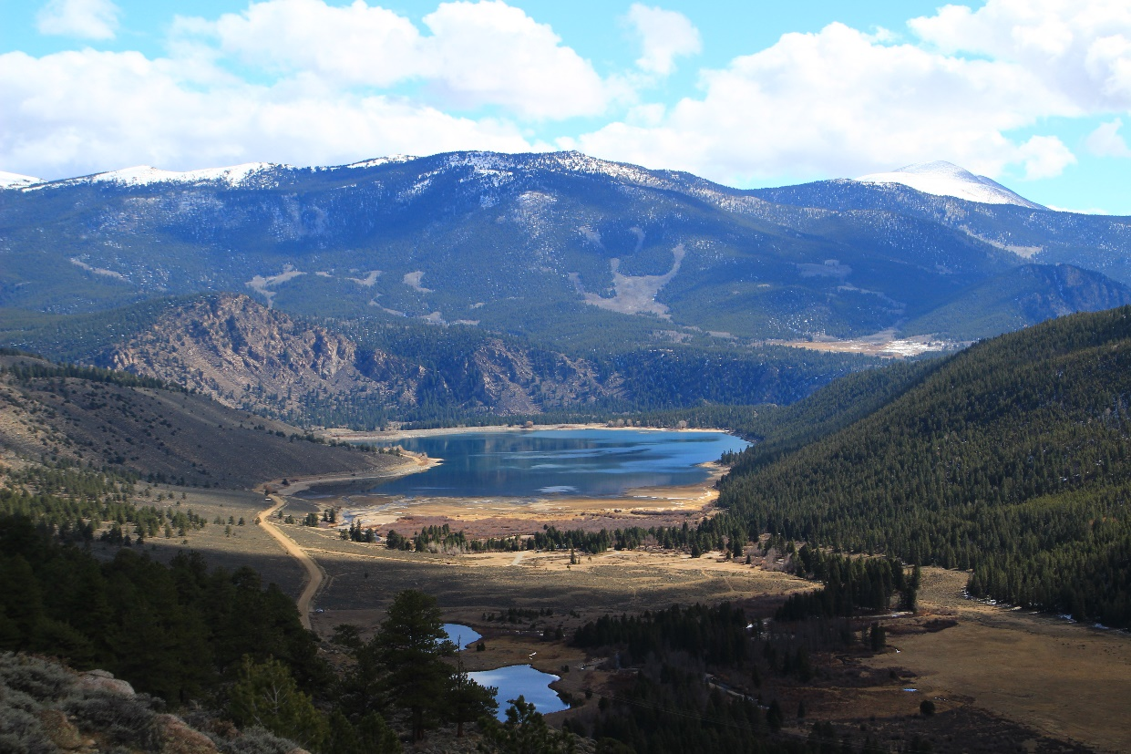
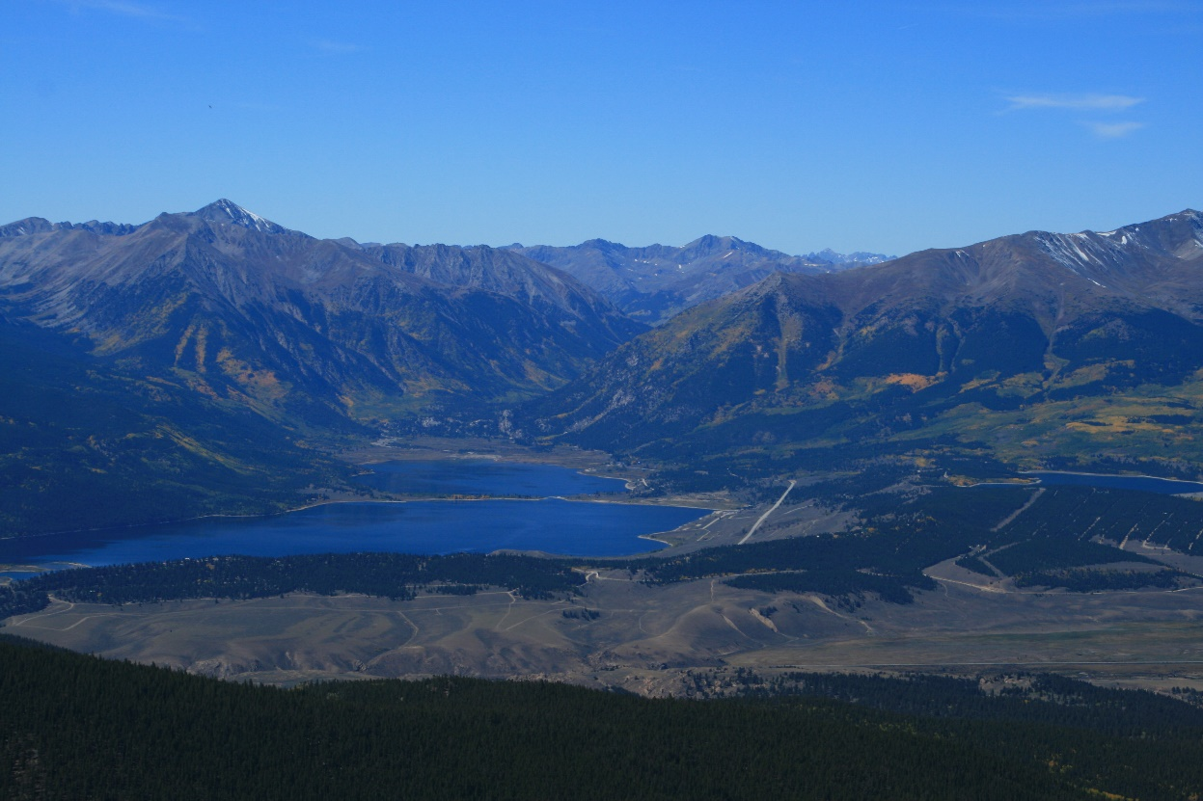
Moraines
Lateral Moraines – Clear Creek
End Moraine – Twin Lakes

Slide 19
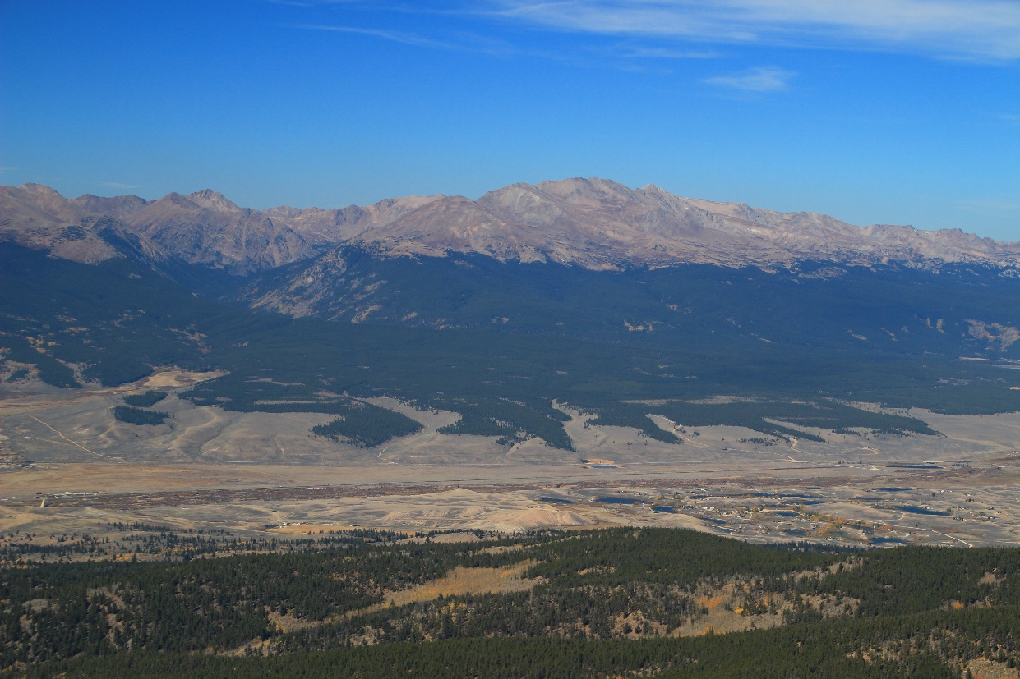
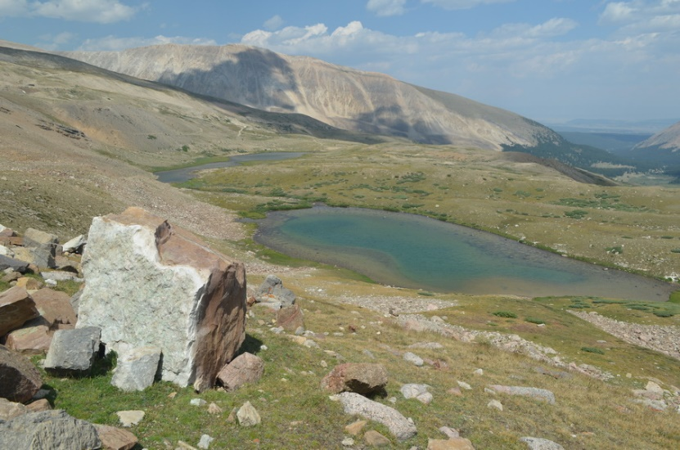
Landforms
Kettles
Glacial Erratics

Slide 20
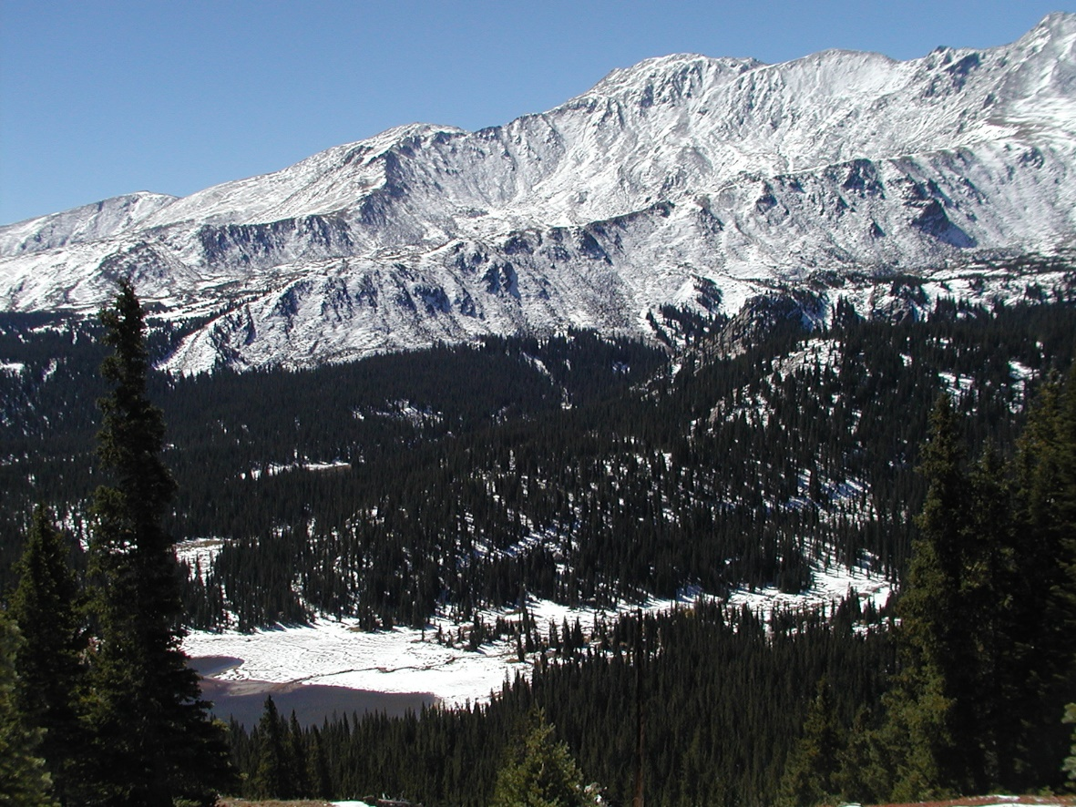
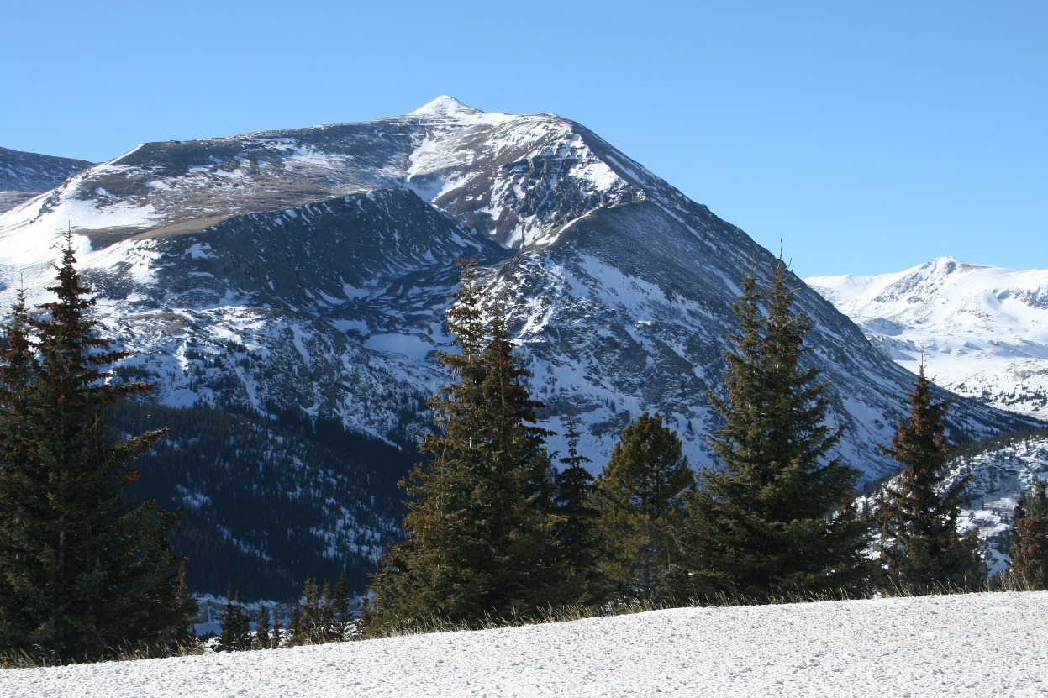
Landforms
Mt. Massive
Mt. Lincoln

