Slide 1
Rift/Uplift Geology of the
Upper Arkansas Valley
Arkansas Headwaters Recreation Area
Ver. 1.0

Slide 2
Geologic Sections of AHRA
Upper Arkansas River Valley
  Leadville to Salida
  Segment of the Rio Grande Rift
Upper Big Horn Sheep Canyon
  Salida to Coaldale
  Canyon through the east horst of the Rio Grande Rift
Lower Big Horn Sheep Canyon / Royal Gorge
  Coaldale to Canon City
  Canyons through the Front Range uplift of the southern Rocky Mountains

Slide 3
Upper Arkansas River Valley
A portion of the Rio Grande Rift running from southern Wyoming into Mexico
  Rift – a portion of Earth’s crust where spreading has occurred
    Caused by tensional forces from the flat-subducting Farallon Tectonic Oceanic Plate activity below the crust
    Elongated blocks of crust (horsts) parallel to and on both sides of a rift rotate and uplift, here to over 7K feet above the graben, while spreading apart
    The area between the spreading blocks (graben) drops along the uplifting fault-bounded blocks forming a valley, here 15K thick with post-rift fill
    The uplifting exposes rocks lower in the rift’s horst walls from thousands of feet deep within the crust
    The spreading allows hydrothermal and volcanic activities from deep within the earth to rise to the surface
      Causing hot spring activity on the west from Cottonwood Creek south to Poncha Pass and Salida
      Causing related volcanic activity on the east from Buffalo Peaks south to Salida and on the west from Independence Pass to Monarch Pass

Slide 4
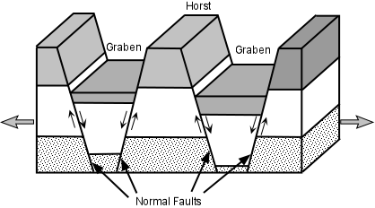
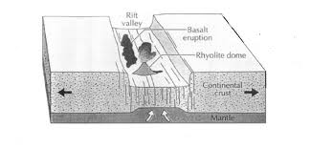
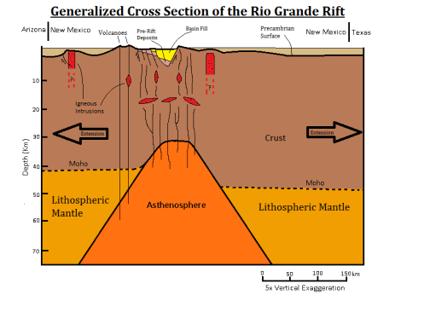
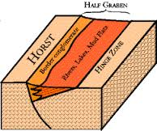
Rift Diagrams

Slide 5
Upper Arkansas River Valley
Geology of the Upper Arkansas Rift Valley
  The Mosquito Range is the east horst and the Sawatch Range is the west horst of the rift valley
  A significant amount of uplifted Precambrian metamorphic basement rock (gneiss and schist) is exposed at the base of both horst walls
  Un-metamorphosed Precambrian basement granites and granite intrusions in the metamorphosed rock are also exposed in the horst walls below the sedimentary rock layers high on the horst walls
  Significant glaciations have occurred to both horst walls to the north end of the valley and in the Sawatch alone to the south end
    Where Lake Creek, Clear Creek, and Pine Creek end at the Arkansas River, banks of glacial till are present as remains of glacial moraines
    Just south of the Granite town site, one or more ice dams that formed during the glacial melt period, creating a 500 foot deep lake, burst to scour out and form the deeper portion of the Granite Canyon area and carry large boulders way downstream (as far as the Spikebuck recreation site)
    The glacial outwash has forced the Arkansas River tightly against the east horst through much of the Upper Arkansas River Valley
  Large deposits of volcanic rhyolite and some andesite remain along the east horst from Bald Mt., Sugarloaf and Ruby Mountains and Rainbow rock south to Salida and predominate from Hecla Junction to the lava flow east of Salida from “S” Mountain
  Along the base of the Sawatch Range south of Mesa Antero, large alluvial fan deposits and planation surfaces contain sorted glacial outwash from flooding draining melting glaciers in the Sawatch
  Mixed with the basement granite and volcanic deposits, the Precambrian basement metamorphics make a significant appearance near Hecla Junction and east of Salida at the base of the east horst

Slide 6
Upper Big Horn Sheep Canyon
A fault system in the east horst of the Rio Grande Rift
  Formed by tensional spreading steeply uplifting huge blocks of crust, forming faults and fractures that the Arkansas River follows
  The uplift and faults slope downward easterly to Coaldale
  Later crustal shifting and volcanism possibly diverted the Arkansas River from a southward flow through Poncha Pass to a southeastward flow following faults through the east horst
Uplifting exposed deep Precambrian rocks up through successive layers of the lower Paleozoic sedimentary rock layers
  Deep Precambrian Meso-Proterozoic Basement metamorphics are exposed just east of Salida
  Rocks traversed just to the east change abruptly to Cambrian/Ordovician white Sawatch sandstone/brownish Manitou limestone/red-yellow Harding quartzite/gray Fremont dolomite
  The massive gray cliffs then encountered are Ordovician Fremont Dolomite/Limestone
  Beyond the dolomite are successive pink Parting Shale/purplish Parting Quartzite/red-yellow Dyer Chert/white-yellow Dyer Dolomite/yellow-green Dyer Shale/grayish Leadville Limestone layers in the Devonian and Mississippian formations severely twisted, faulted, and bent behind Wellsville by crustal east horst uplift
  From Swissvale to Vallie Bridge, the uppermost sedimentary layer for this region, the purple sandstone/green-brown-black shales/red-white Pennsylvanian/Permian redbeds, are passed
    The redbeds consist of red and white sandstone/shale/mudstone/conglomerate layers
    Up to approximately 22,000 feet in thickness
  Some areas on the tops of the ridges to the north and across the river east of Rincon and west of Howard are capped with Salida Volcano Field andesite flows
  To the northeast of Howard, beds of white to reddish rhyolite ash cap the Permian redbeds
Just west of Coaldale (at Vallie Bridge), the sediment layers traversed near Wellsville were caught and bent up nearly vertical by the west edge of the Front Range uplift
Steeply dipping sedimentary layers to the southwest of Coaldale on the top of the east horst contain coal and gypsum

Slide 7
Lower Big Horn Sheep Canyon / Royal Gorge
Canyons through the massive Front Range uplift
  Major tectonic crustal uplift of deep Precambrian Meso-Proterozoic basement granites and metamorphics
  The crust here is deeply faulted and fractured by the 10K+ feet of uplift
  The Arkansas River follows faults and fractures through the uplifted mountains
  The abrupt west end of the uplift at Coaldale marks the east extent of the east Rio Grande horst and the river enters the Front Range Uplift through a water gap
Geology of the canyons
  The west most ridge of the uplift visible approaching Coaldale from the northwest is made up of tan Precambrian granites with a some dark metamorphic rock
  From Coaldale to Texas Creek, the uplift consists of tan/pink/orange Precambrian granites and black gabbro with metamorphic gneiss and schist
  To the north, the ridges are capped with 39-mile Volcano Field basalt lava flows
  Deep in the canyon east of Texas Creek to Parkdale, rocks are primarily Meso-proterozoic metamorphics uplifted from deep within the crust
    Gneiss, schist, and Proterozoic/Archean metasediments persist, especially around Texas Creek
    The walls contain few original basement granite masses but many granite intrusions introduced after the metamorphosing of this portion of the crust
  At Parkdale, a tilted and severely faulted outlier of Mesozoic Morrison, Dakota, etc. sedimentary rock layers are visible trapped by the uplift of the basement rock
  East and south of Parkdale, the southward continuation of the Front Range uplift from Pikes Peak is visible
  Royal Gorge rock consists of granites, gneiss, and schist with huge granite masses and black intrusions of gabbro contained in the gneiss

Slide 8
North American Plate Tectonics Affecting Us
In moving west, the North American Plate slid over several ancient plates, pushing up the North American Cordillera
  The Cordillera is the great belt of mountains from Alaska to Panama
  The most important overridden plate is the Farallon Plate
    It is the largest seabed oceanic plate to plunge under the North American Plate
    It extended from todays Juan de Fuca Plate on the north through the Cocos Plate on the south
    Its subduction built most of the North American Cordillera, bunching up the west end of the North American plate like folds

Slide 9
North America (cont.)
The Farallon Plate was separated from the Pacific Plate by the Farallon-Pacific Ridge, a spreading zone in Earth’s crust
  Migrating west across the ridge, the North American Plate made contact with the Pacific Plate migrating northwest, creating the transform San Andreas Fault that grew north and south
    Due to their similar directions of movement, the result of the collision was not subduction but side-to-side movement
    Continental stretching of North America was also created by the migration, the Basin and Range Province sitting today over what was the Farallon-Pacific Ridge spreading zone
    Two remnants of the Farallon Plate, where the continent has not overridden the ridge, still today subduct, the Juan de Fuca Plate and the Cocos Plate

Slide 10
Our Foreland Ranges
The Southern Rockies of southern Montana, Wyoming, Colorado, and northern New Mexico
  600 to 1000 miles inland from the west edge of the North American Plate
  They occur unusually deep in the continental interior to be the result of normal oceanic/continental plate subduction
  They started to rise in the Laramide Orogeny
  Massive sideways pressure caused by the Farallon Plate compressed the continental basement and squeezed up the Foreland Ranges
  Colorado and Wyoming were squeezed to 4/5ths their original widths
  Their uplifted cores are made of basement rock

Slide 11
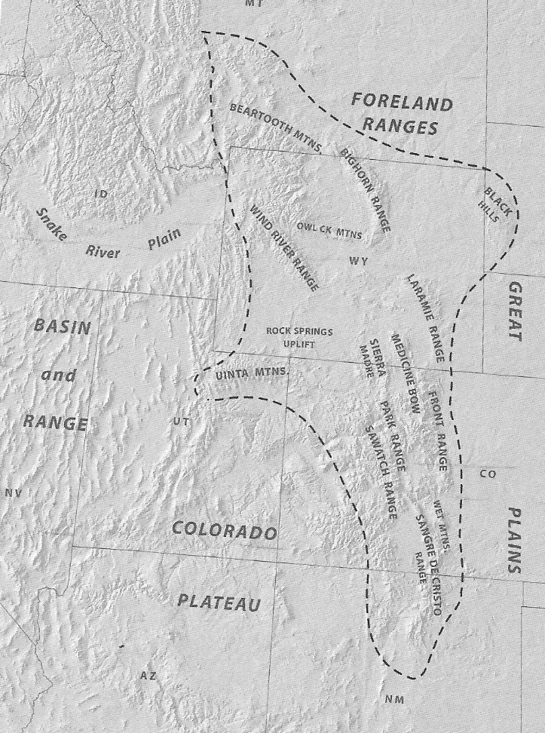
Our Foreland Ranges

Slide 12
Our Foreland Ranges (cont.)
The Farallon Plate probably subducted flat in a 500-mile wide zone from southern Montana to northern New Mexico
  This wide zone was probably an oceanic plateau of vast quantities of lighter basaltic volcanic rock vented onto the seabed up to 20 miles thick
  The buoyancy of the plateau material floats the plate upward in the mantle so it slides flat beneath the continent as a great arch and may even tear away from the plate like a large flap
  Only 10 extra miles of plateau top layer basalt/gabbro on peridotite is needed to float the plate
  The flat-sliding plate applied the pressure as it scraped the North American Plate above
  An on-going event today may be demonstrating the same processes involved in the formation of the Foreland Ranges – Argentina’s Pampean Ranges being pushed up by nearly flat subduction of the Nazca Plate between 28 and 33 degrees latitude South

Slide 13
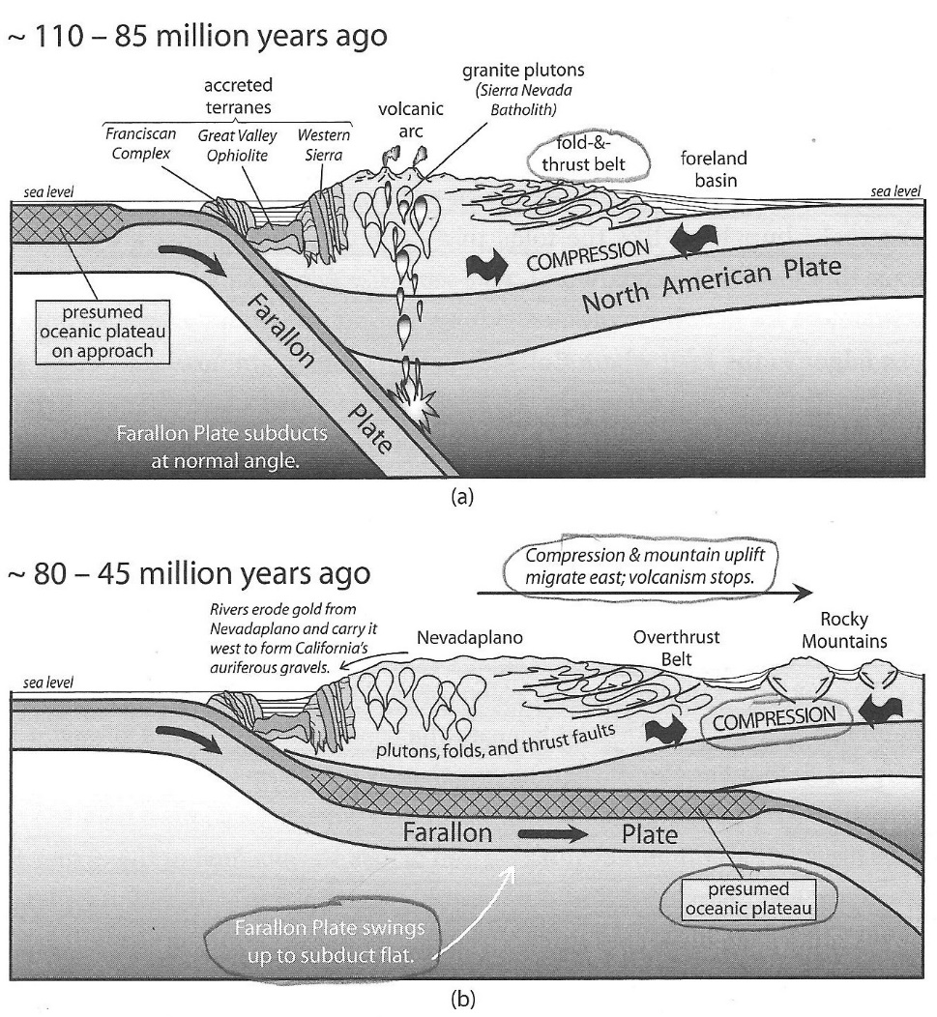
Flat Subduction Period

Slide 14
Our Foreland Ranges (cont.)
  After the Laramide Orogeny, the Farallon Plate bent back to normal subduction as the oceanic plateau moved through
    Volcanoes re-awakened with a vengeance
    Flat subduction may have been to blame for such violent volcanism
      As the Farallon Plate slid flat, great pressures may have squeezed quantities of seawater into the lower continental crust above
      When the Farallon Plate angled back down, inflowing soft mantle above the plate began to melt by depressurization and, also, water lowered the melting point in the mantle
      As fresh magma entered the hydrated crust above, it could have exploded up to 750 times its volume

Slide 15
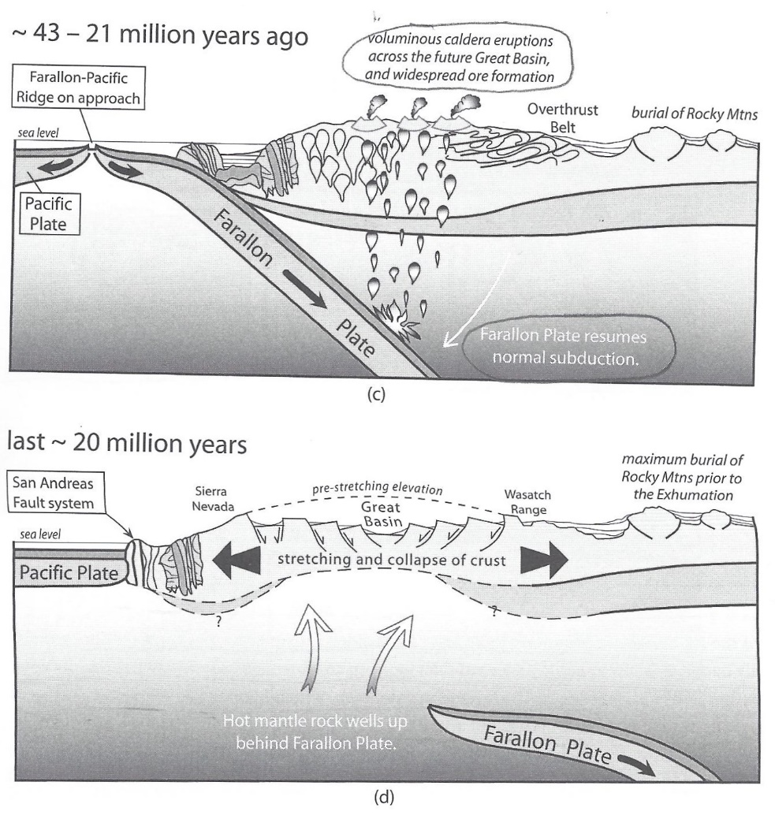
Normal Farallon Plate Subduction

Slide 16
Our Foreland Ranges (cont.)
  The Death of the Farallon Plate
    The USArray has shown that the Farallon Plate itself is largely gone today
    The destruction of the Farallon Plate has several causes
      The North American Plate overtopped the Farallon-Pacific Ridge from which the Farallon Plate grew and slid east, eliminating the plate’s source and energy
      The westward movement of the North American Plate over the now dead Farallon Plate has broken it up
        Subduction and plate movement ended
        When the detached dead plate cracked apart into several pieces, it sank into the mantle opening gaps through which hot mantle rocks and magma rose
      As the west gap opened, more hot mantle rock welled up under the Southern Rocky Mountains to push them up

Slide 17
Our Foreland Ranges (cont.)
Today with the USArray, geologists can see the remnants of the ripped-apart Farallon Plate in the mantle
  Several fragments into which it has been split are clearly visible
  The high oceanic plateau fragment 300 miles under the Great Plains that looks like the flat subducting portion of the plate that slid underneath the continent, to squeeze up the Southern Rockies, is clearly identifiable
  A severely tilted fragment under the Southern Rockies that probably was the cause of the tensional forces causing the crust to split into the Rio Grande Rift (with its associated horst uplifts), the buckling and warping of the Colorado Plateau, and the depressurization to create the magma necessary for the Front Range Uplift and other regional volcanism under the Southern Rocky Mountain region
  The Southern Rockies today are still stretching east-to-west along the Rio Grande Rift caused by the pressure of diving Farallon Plate fragments and upwelling hot mantle

Slide 18
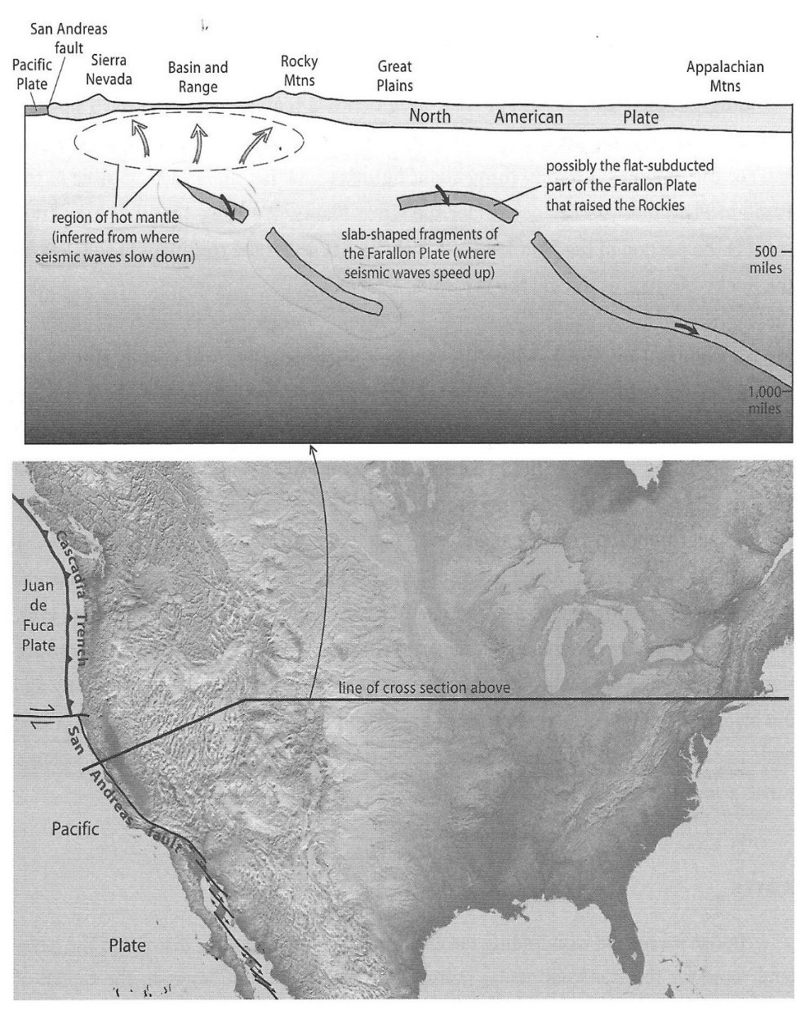
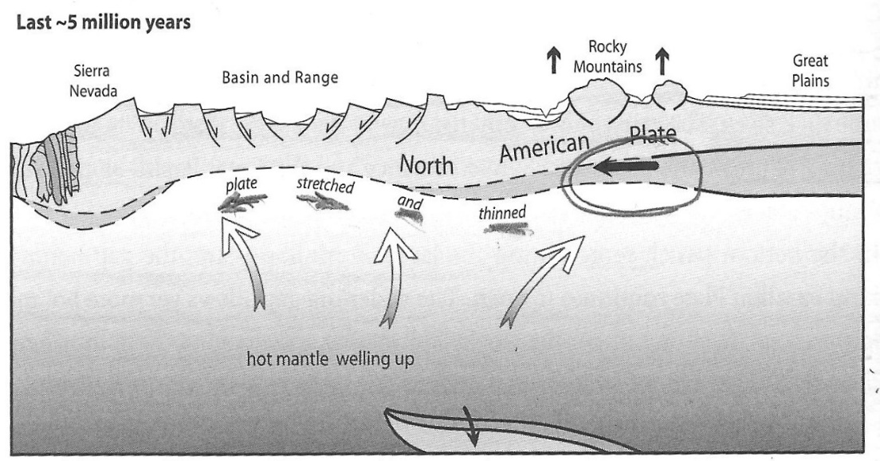
Death of the Farallon Plate
Adapted from Meldahl 2013 (p.213)

Slide 19
References
Chesterman, Charles W. National Audubon Society Field Guide to Rocks and Minerals. New York, NY: Chanticleer Press, 1979, 1988
Chronic, Halka and Williams, Felicie. Roadside Geology of Colorado, Second Edition. Missoula, MT: Mountain Press, 2002, 2010
Lutgens, Frederick K. and Edward J. Tarbuck. Essentials of Geology, Eighth Edition. Upper Saddle River, NJ: Prentice Hall, 2003, 2000,1998, 1995
Matthews, Vincent, Katie KellerLynn and Betty Fox. Messages in Stone: Colorado’s Colorful Geography. Denver: Colorado Geological Survey, 2003
Meldahl, Keith Heyer. Rough-Hewn Land, Berkeley and Los Angeles, CA: University of California Press, 2011, 2013
Reed, Jack and Ellis, Gene. Rocks Above the Clouds. Golden, Colorado: Colorado Mountain Club Press, 2009

